Slide 1

The Power of Graph:
Behind the API That Drives the Cloud
Sebastiaan de Wolf
Notes:
Make sure you have open:
Documentation
Intune
Graph explorer (logged in)

Slide 2
What is the Graph API?
Rest API
Access (m)any Microsoft Cloud service resources
  Azure
  Entra Id
  Intune
  ...
Used by Microsoft itself
Resources
  Documentation
  Graph Explorer
Notes:
Used by Microsoft itself
backend of most portals

Slide 3
Quirks
v1.0 vs beta
pagination
throttling
different output formats
Notes:
v1.0 vs beta
doesn’t follow more traditional way of releasing higher versions in the future (they just keep adding & also changing the v1.0)
Microsoft says not to use beta because of possibilities of change, but they use it themselves
missing documentation (mostly beta, but sometimes v1.0)
pagination
too many results to return in 1 go, so it uses a nextlink property for another call with more results
throttling
‘overusage’ of the api so Microsoft will throw an error 429
fixed by waiting a bit before continuing
is determined tenant wide, so if multiple people or processes are querying the Graph api, they will all be throttled no matter their individual amount of graph calls
different output formats
usually a straightforward JSON with object and properties (hashtable format)
sometimes downloadable csv files, sometimes a schema and values (not actual properties)

Slide 4
Our end goal
Generate a list of all noncompliant devices
with the accompanying compliance policies
and the specific setting included.
Notes:
Generate a list of all noncompliant devices
with the accompanying compliance policies
and the specific setting included.

Slide 5
How do we start?
Can you find this information or parts of it in a portal somewhere?
Check in your browser how Microsoft gathers the information
Once you know the calls, you can experiment
e.g. with Graph Explorer
Notes:
Quick demo of using the network tab and then using the graph explorer

Slide 6
List of noncompliant devices
https://graph.microsoft.com/v1.0/deviceManagement/managedDevices
returns all managed devices
$filter=complianceState eq ‘noncompliant’
filters for all noncompliant devices
$select=id,deviceName,complianceState,model,userId,userPrincipalName
→ only gets these properties for each device
Notes:
exists on both beta & v1.0
if you can choose, always pick v1.0 → this is usually a lot faster & efficient
beta version has more properties sometimes you might want to use
filter
to limit the amount of results you get (for ease & also avoid being throttled)
select
to lighten the load of the graph call itself to avoid being throttled

Slide 7
List of noncompliant devices
GET https://graph.microsoft.com/v1.0/deviceManagement/managedDevices?$filter=complianceState eq ‘noncompliant’&$select=id, deviceName, complianceState, model, userId, userPrincipalName
Example return:
{
"id": "c7776ce9-fc68-4cc9-8d78-e4f7982c0265",
"deviceName": "Demo Device",
"complianceState": "noncompliant",
"model": "Surface Laptop 4",
"userId": "958b0804-346e-4b84-8191-e2009d55b286",
"userPrincipalName": "example.user@wpninjas.be"
}, ...
Notes:
is a GET request because we are not changing anything
full result

Slide 8
What’s next?
We have the list of noncompliant devices in our tenant
we need the compliance policies that are being broken per device
In the exact same manner, we attempt to find this information
check the MS portals
Notes:
Another quick demo of using the network tab and then using the graph explorer

Slide 9
Compliance policies per device
https://graph.microsoft.com/beta/deviceManagement/reports/getDevicePoliciesComplianceReport
(include device id in the filter in the body)
returns all compliance policies and their details specifically for this device
Filter
correct device (mandatory)
noncompliant policies
Select
useful properties
e.g. PolicyId, PolicyStatus, DeviceId, LastContact, ...
Notes:
specific call only exists on beta
filter
filters other devices out
status 4 is the noncompliant status
select
only return interesting properties to lighten the load

Slide 10
Compliance policies per device
POST https://graph.microsoft.com/beta/deviceManagement/reports/getDevicePoliciesComplianceReport
body:
{
"filter": "(DeviceId eq ‘5d963f09-7ed9-42f7-9873-0fb3d128390a’) and (PolicyStatus eq ‘4’)",
"select": ["PolicyId", "PolicyName", "PolicyStatus", "DeviceId", "UPN", "LastContact"]
}
Notes:
Needs to be a POST call because we have a request body
full result

Slide 11
Compliance policies per device
Example return:
[
"5b99458f-3942-4900-a740-1531a7637071",
"2025-11-18T18:08:39",
"1a1d9d45-c876-4b49-912e-609e48239bcb",
"Demo Device Compliance Policy",
4,
"Not compliant",
"example.user@wpninjas.be"
], ...
Notes:
Schema is returned + Values property
Very unreadable
"Schema": [
{
"Column": "DeviceId",
"PropertyType": "String"
},
{
"Column": "LastContact",
"PropertyType": "DateTime"
},
{
"Column": "PolicyId",
"PropertyType": "String"
},
{
"Column": "PolicyName",
"PropertyType": "String"
},
{
"Column": "PolicyStatus",
"PropertyType": "Int32"
},
{
"Column": "PolicyStatus_loc",
"PropertyType": "String"
},
{
"Column": "UPN",
"PropertyType": "String"
}
]

Slide 12
Schema
DeviceId
LastContact
PolicyId
PolicyName
PolicyStatus
PolicyStatus_loc
UPN
"Schema": [
{
"Column": "DeviceId",
"PropertyType": "String"
},
{
"Column": "LastContact",
"PropertyType": "DateTime"
},
{
"Column": "PolicyId",
"PropertyType": "String"
},
...
]
Notes:
Specific schema on the right side
Quick list of property names on the left
-> Manual action needed to structure this into more readable and usable format

Slide 13
Organised result
{
"DeviceId": "5b99458f-3942-4900-a740-1531a7637071",
"LastContact": "2025-11-18T18:08:39",
"PolicyId": "1a1d9d45-c876-4b49-912e-609e48239bcb",
"PolicyName": "Demo Device Compliance Policy",
"PolicyStatus": 4,
"PolicyStatus_loc": "Not compliant",
"UPN": "example.user@wpninjas.be"
}, ...
Notes:
Manually restructured into more JSONlike object

Slide 14
What’s next?
We have the list of noncompliant devices in our tenant
We have the broken compliance policies per device
we need the specific settings that are not being met
In the exact same manner, we attempt to find this information
check the MS portals
Notes:
Another another quick demo of using the network tab and then using the graph explorer

Slide 15
Compliance policy settings per device
https://graph.microsoft.com/beta/deviceManagement/getDevicePolicySettingsComplianceReport
(include device id & policy id in the filter in the body)
returns all settings and their details specifically for this device and policy
Filter
correct device (mandatory)
correct policy (mandatory)
noncompliant settings
Select
useful properties
e.g. SettingId, SettingName, SettingStatus, PolicyId, ...
Notes:
specific call only exists on beta
filter
filters other devices out
filters other policies out
status 4 is the noncompliant status
select
only return interesting properties to lighten the load

Slide 16
Compliance policy settings per device
POST https://graph.microsoft.com/beta/deviceManagement/reports/getDevicePolicySettingsComplianceReport
body:
{
"filter": "(DeviceId eq ' 306b1304-7cf4-44d6-8f1a-7acf2423df3f') and (PolicyId eq ' d2edef51-f12a-4d50-931a-41724a0c0b6a') and (SettingStatus eq '4’)",
"select": ["SettingId", "SettingName", "SettingNm", "SettingStatus", "DeviceId", "PolicyId", "UserId"]
}
Notes:
full result

Slide 17
Compliance policy settings per device
Example return:
[
"15f17a4a-a442-4a94-b4fa-4d7a28e40edb",
"1a84ba1c-4590-48b7-bbbe-45c4fd5efa35",
"f81c59f0-edec-48eb-8016-a7a572802fdc",
"DemoDeviceCompliancePolicy.RequireRemainContact",
"DemoDeviceCompliancePolicyRequireRemainContact",
"Is active",
4,
"Not compliant",
"99392e9e-85c3-408f-aad1-478376f34129"
], ...
Notes:
Schema is returned + Values property
Very unreadable
"Schema": [
{
"Column": "DeviceId",
"PropertyType": "String"
},
{
"Column": "PolicyId",
"PropertyType": "String"
},
{
"Column": "SettingId",
"PropertyType": "String"
},
{
"Column": "SettingName",
"PropertyType": "String"
},
{
"Column": "SettingNm",
"PropertyType": "String"
},
{
"Column": "SettingNm_loc",
"PropertyType": "String"
},
{
"Column": "SettingStatus",
"PropertyType": "Int32"
},
{
"Column": "SettingStatus_loc",
"PropertyType": "String"
},
{
"Column": "UserId",
"PropertyType": "String"
}
]

Slide 18
Schema
DeviceId
PolicyId
SettingId
SettingName
SettingNm
SettingNm_loc
SettingStatus
SettingStatus_loc
UserId
"Schema": [
{
"Column": "DeviceId",
"PropertyType": "String"
},
{
"Column": "PolicyId",
"PropertyType": "String"
},
{
"Column": "SettingId",
"PropertyType": "String"
},
...
]
Notes:
Specific schema on the right side
Quick list of property names on the left
-> Manual action needed to structure this into more readable and usable format

Slide 19
Organised result
{
"DeviceId": "15f17a4a-a442-4a94-b4fa-4d7a28e40edb",
"PolicyId": "1a84ba1c-4590-48b7-bbbe-45c4fd5efa35",
"SettingId": "f81c59f0-edec-48eb-8016-a7a572802fdc",
"SettingName": "DemoDeviceCompliancePolicy.RequireRemainContact",
"SettingNm": "DemoDeviceCompliancePolicyRequireRemainContact",
"SettingNm_loc": "Is active",
"SettingStatus": 4,
"SettingStatus_loc": "Not compliant",
"UserId": "99392e9e-85c3-408f-aad1-478376f34129"
}, ...
Notes:
Manually restructured into more JSONlike object

Slide 20
POSSIBLE ISSUE !
Notes:
We set up SettingStatus eq ‘4’ in the previous call
this was not working as intended
sometimes unexpected behaviour occurs due to something wrong or strange on MS side

Slide 21
How to fix
Problem: provided filter in Graph call does NOT work
Solution
omit the setting status filter
filter it out yourself in code AFTER
(less optimized for avoiding throttling)
This will always work, even after MS (potentially) fixes the problem in the future
Case by case
Notes:
How to fix
In this case, it would be best to omit the setting status filter and filter it out yourself in code
→ That way it will always work, even after MS fixes the problem in the future
Case by case

Slide 22
IMPORTANT TO TEST GRAPH CALLS AND REVIEW RESPONSE ! (even in 1.0)
Notes:
IMPORTANT TO TEST GRAPH CALLS AND REVIEW RESPONSE ! (even in 1.0)

Slide 23
Did we achieve our goal yet?
Our goal:
Generate a list of all noncompliant devices
with the accompanying compliance policies
and the specific setting included.
We have all the information we need
→ format & export !
Notes:
Use your preferred programming language

Slide 24
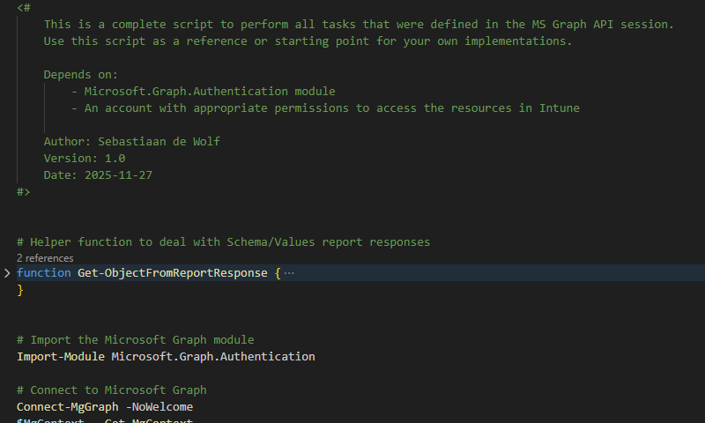
PowerShell script
Available on GitHub
https://github.com/
sealionforever/sessions
Notes:
In PowerShell → very easy to deal with objects + MGGraph module for authentication & error handling (doesn’t do pagination or weird output formats)
Available on GitHub with these slides

Slide 25
Any questions?

